Slide 1
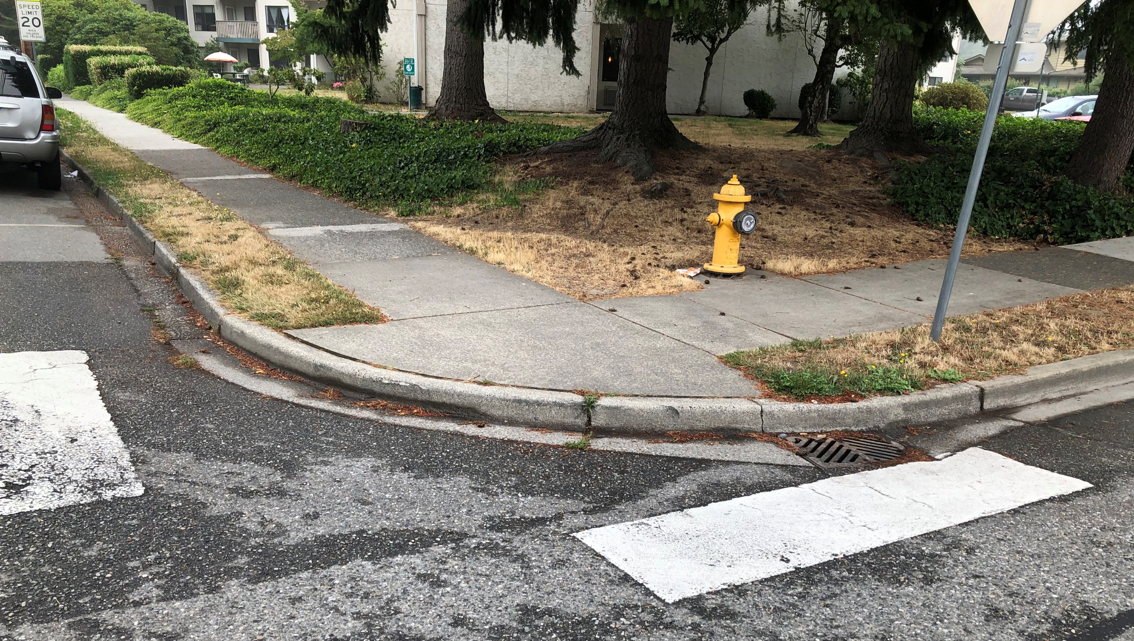
ADA Transition Plan Virtual Workshop
Thursday, November 5, 2020 6:00 - 7:30 pm

Slide 2
Agenda
Highlight ADA Transition Plan purpose
Share existing barrier conditions data
Identify/locate barriers
Prioritize barriers for removal

Slide 3
How to Participate
We plan to stop and address questions when you see the following message: Raise Hand or Write Question in Q&A Box
You are welcome to enter questions into the Q&A Box at any time and we will attempt to address questions as they come in
There will be more Q&A time after the presentation

Slide 4
What should an ADA Transition Plan do?
Identify accessibility barriers
Describe methods used to remove accessibility barriers
Provide a barrier removal schedule
Identify public official responsible to implement plan

Slide 5
Types of Barriers under Title II (Local & State Governments)
Physical barriers
Public right-of-way
City building facilities
City parks
Programmatic barriers

Slide 6
Existing Conditions for Physical Barriers

Slide 7
Physical Features
Curb Ramps
Blended Transitions

Slide 8
Curb Ramp Inventory (926 Total)

Slide 9
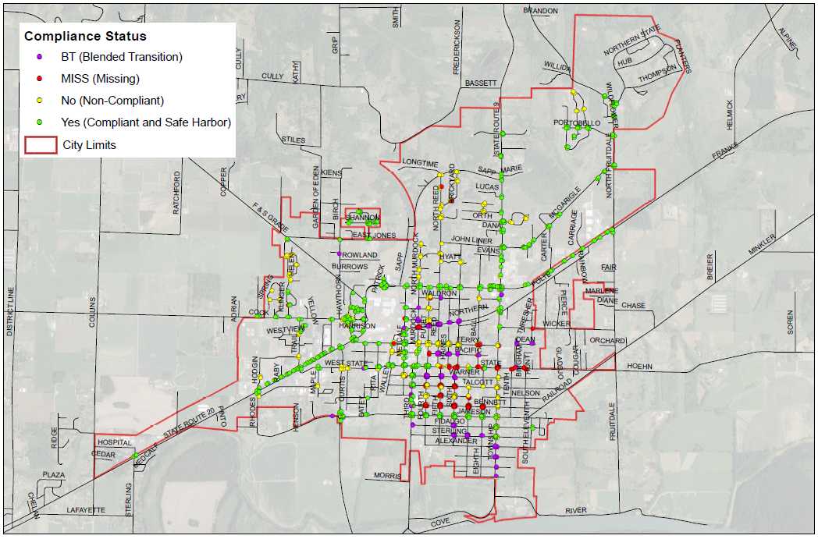
Physical Feature Inventory Map

Slide 10
Examples of Physical Barriers in Sedro-Woolley

Slide 11
Missing Curb Ramps

Slide 12
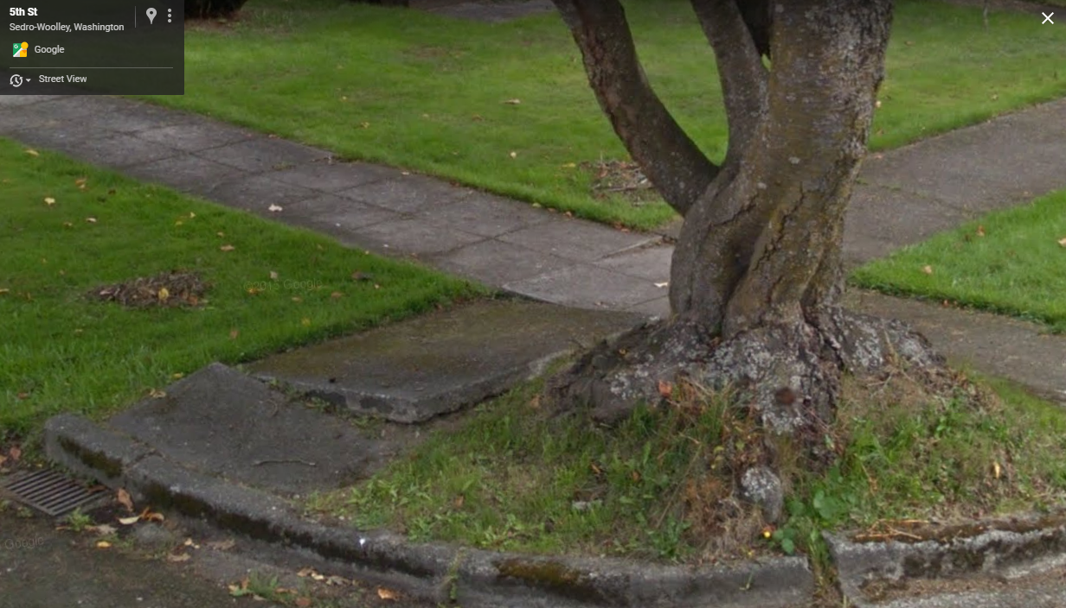
Sidewalk Cracks or Upheaval

Slide 13
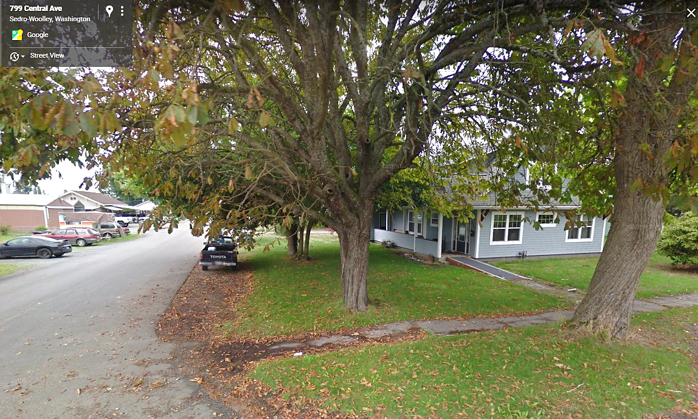
Missing Blended Transition

Slide 14
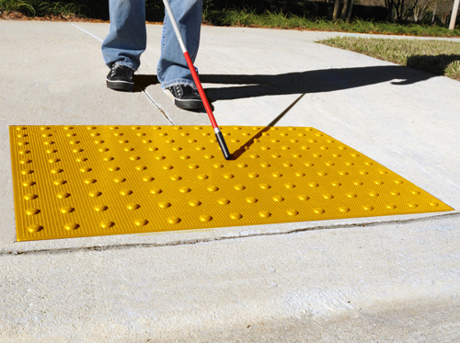
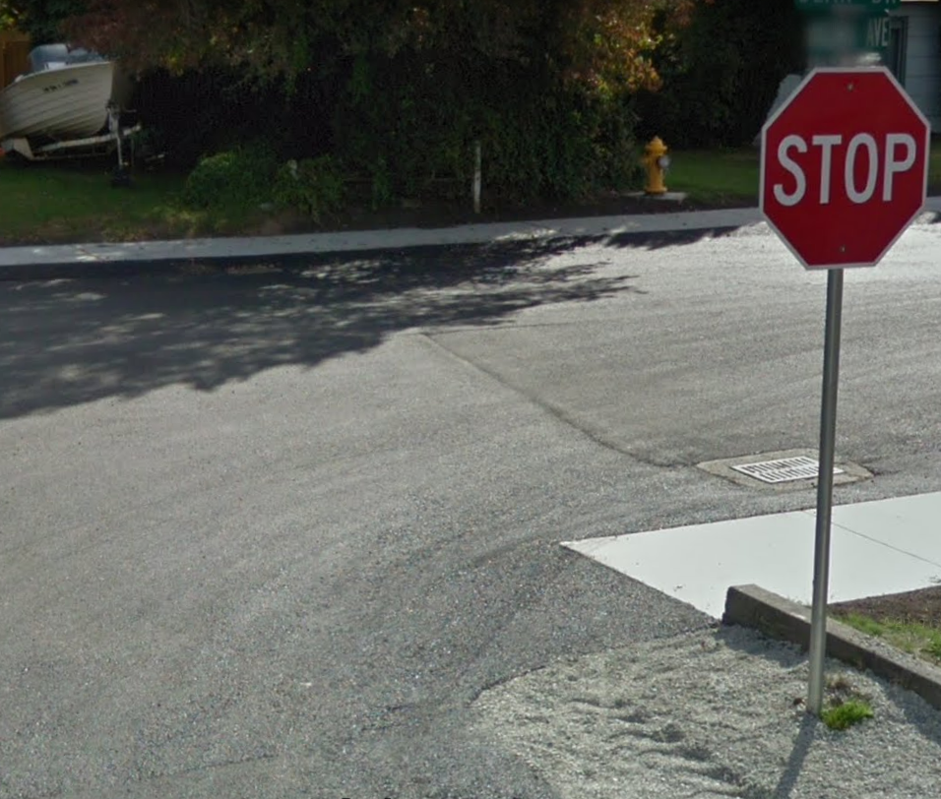
Missing Detectable Warning Surfaces

Slide 15
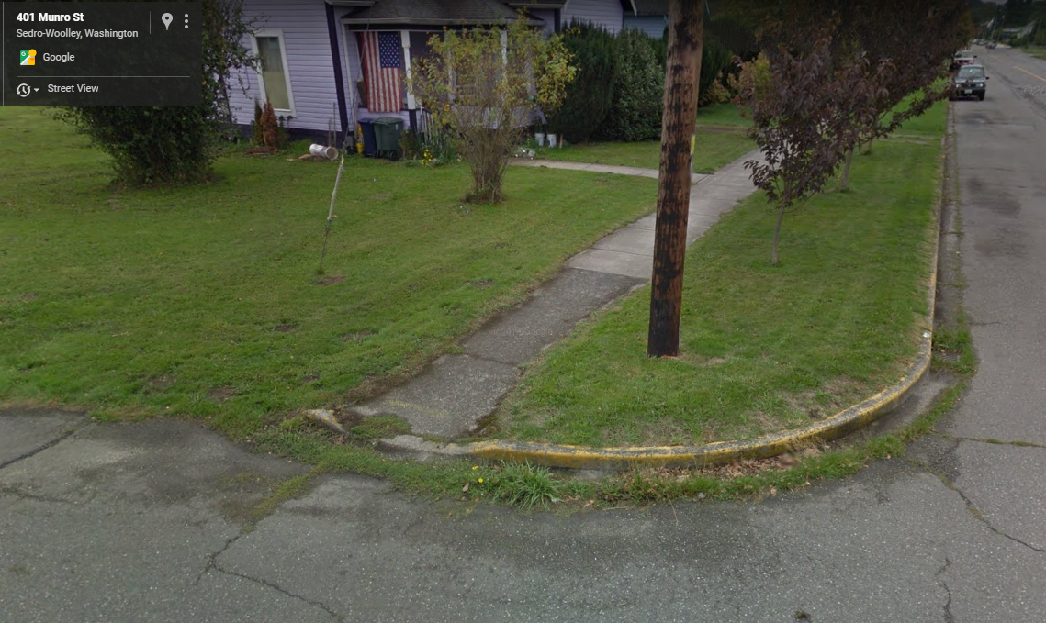
Narrow Path of Travel

Slide 16
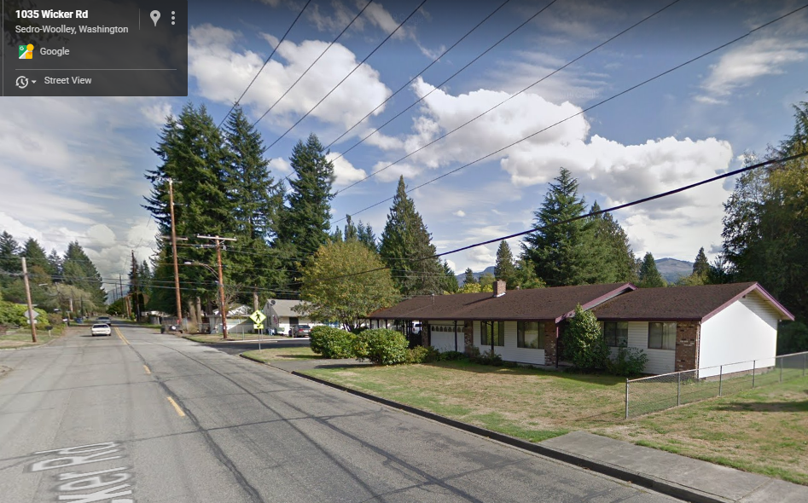
Missing Sidewalk Segments

Slide 17
Building and Park Barriers
Approach and Entrance Exterior to Facility: parking, routes, doors, ramps, curb ramps, steps
Access Interior to Facility: routes, built-in objects (counters), seating, doors
Restrooms and Showers: doors/signs, plumbing fixtures, soap dispensers, hand dryers, grab bars
Other Amenities and Emergency Services: drinking fountains, telephones, fire alarms

Slide 18
Identify Physical Barriers
What types of physical barriers do you experience?
Where are these barriers?
Please Raise Hand or Write Question in Q&A Box

Slide 19
Prioritize Physical Barriers (1)
Which types of barriers are most important for the City to remove first?
Please Raise Hand or Write Question in Q&A Box
Missing curb ramps
Missing pedestrian crossings
Missing accessible pedestrian signals (APS)
Missing sidewalks
Sidewalk cracks/bumps
Fixed objects in path of travel
Overgrown vegetation
Buildings/Facilities barriers
Other?

Slide 20
Prioritize Physical Barriers (2)
Where is it the most important for the City to remove barriers?
Please Raise Hand or Write Question in Q&A Box
Transit Centers, Routes, & Stops
Grocery and Retail Stores
Schools and Libraries
My residence
Senior Center/Care Facilities
City Buildings and Post Office
Medical Clinics
Parks and Trails
Other? (Grab bars for doors, etc.)

Slide 21
Existing Conditions for Programs, Services and Activities
ADA/504 Coordinator
Public ADA Notice
ADA Grievance Procedure
Policy Regarding Installation of Accessible Pedestrian Signals (APS)
Website accessibility
Printed materials
Public meeting accommodations
Program eligibility/participation
Alternative format requests

Slide 22
Identify Programmatic Barriers
What types of barriers do you experience accessing City programs, services or activities?
Please Raise Hand or Write Question in Q&A Box
Website accessibility
Printed materials
Public meeting accommodations
Program eligibility/ participation
Alternative format requests
Other?

Slide 23
Prioritize Programmatic Barriers (1)
Which types of barriers are most important for the City to remove first?
Please Raise Hand or Write Question in Q&A Box
Website accessibility
Printed materials
Public meeting accommodations
Program eligibility/ participation
Alternative format requests
Other?

Slide 24
Prioritize Programmatic Barriers (2)
Where is it most important for the City to remove barriers?
Please Raise Hand or Write Question in Q&A Box
Digital Services
In-Person Services
Other?

Slide 25
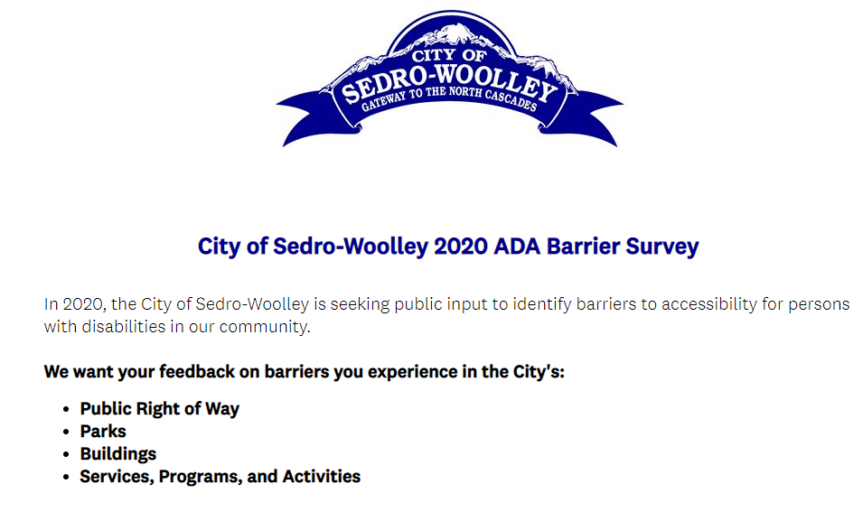
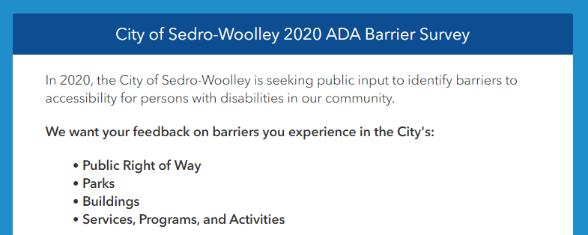
If you think of any more barriers, please fill out our survey by November 8!
Screen-Reader Friendly Survey
Map-Enabled Survey

Slide 26
Links for both surveys are available on the City’s ADA Transition Plan project webpage:
https://www.ci.sedro-woolley.wa.us/resources/ada_transition_plan.php

Slide 27
How will the City implement the barrier findings into the ADA Transition Plan?
The Plan will:
Include public feedback findings in prioritization criteria
Develop a schedule for barrier removal
Develop a financial plan to fund barrier removal
Develop a monitoring tool to track barrier removal to include:
Annual progress reports
Schedule for future ADA Transition Plan Updates

Slide 28
How will the City prioritize curb ramp barriers?
Proximity to Planned City Projects
Proximity to Likely ADA Destinations:
Transit Centers, Routes, & Stops
Grocery and Retail Stores
Schools and Libraries
Senior Center/Care Facilities
City Buildings and Post Office
Medical Clinics/Pharmacies
Parks and Trails
Curb Ramp Rating
Missing (D)
Non-Compliant (C)
Non-Compliant (B)
Public Feedback
Online surveys
Virtual workshop

Slide 29
How will the City prioritize other physical barriers?
Planned City Projects for sidewalk and parking barriers
Planned Capital Facilities Projects for buildings and parks
Accessible Pedestrian Signal Policy
Public Feedback
Online Surveys
Virtual Public Workshop

Slide 30
How will the City prioritize programmatic barriers?
Administrative requirements of WSDOT Local Agency Guidelines:
ADA/504 Coordinator
Grievance Procedure
Public Notice of ADA Provisions
Accessible Pedestrian Signal (APS) Policy
Public Feedback
Online surveys
Virtual Workshop
Longer-Term Items
Effective Communication
Website Accessibility
Emergency Communication Services
Eligibility/Participation
Existing Facilities Used
Tours and Transportation
Public Meetings
Use of Contracted Services
Employment Procedures

Slide 31
Q & A The Draft ADA Transition Plan will be open for public comment in early 2021 The City of Sedro-Woolley thanks you for participating!
https://www.ci.sedro-woolley.wa.us/resources/ada_transition_plan.php

